Slide 1

SOFTWARE DEVELOPEMENT
FACULTY NAME : SWATI JN
SLOT : c2+tc2
review-1 SIDHARTH BANSAL(19BCE2080)
Aniket singh (19bce2103)
Madhav h nair (19BCI0125)

Slide 2

ABSTRACT
In this project, we propose a software tool to extract unified modelling language (UML) class diagrams. The UML class diagram facilitates the developers' ability to examine the entities and their relationships in the software system. The extracted diagrams enhance software maintenance and evolution. Many developers who implement computational science and engineering software have adopted the object-oriented (OO) Fortran paradigm. One of the challenges faced by OO Fortran developers is the inability to obtain high level software design descriptions of existing applications. Knowledge of the overall software design is not only valuable in the absence of documentation, it can also serve to assist developers with accomplishing different tasks during the software development process, especially maintenance and refactoring. The software engineering community commonly uses reverse engineering techniques to deal with this challenge. A number of reverse engineering-based tools have been proposed, but few of them can be applied to OO Fortran applications.
REVERSE ENGINEERING TOOL TO CONVERT JAVA CODE INTO UML DIAGRAM

Slide 3
It is in the scope of Java to UML diagram converter to provide the UML diagram of the java code that is given as an input in a ZIP file.
It can be used as a software in many schools and universities to teach students how to code in java. It can also be used by software developers working in big tech companies to resolve any bugs in the huge code base.
It is not in the scope of the current software to accept the code in any other language or in any other file format.
Scope

Slide 4
The objective of this project is to help software developers to understand complex architecture written in java and teachers in school and universities can use this to explain their code to students in a graphical way to understand complex concepts of java object-oriented programming.
Objective

Slide 5
Most of the online UML parsers that are available online are not free and requires login. So, we wanted to make a UML parser available to every software developer and professors who teach Java in schools or universities. This parser does not require any authentication and free to use for everybody.
Motivation

Slide 6
A parser which converts Java source code into UML class diagram and sequence diagram.
Java is an object-oriented programming language. Everything in java is an object. Object are made of classes which consist of different data members like variables, constructors, functions etc.
Classes have certain properties like inheritance through which we can access the data members of inherited class.
User through a project will be able to make a class diagram which will get converted to an image. The image will show all the classes with its variables and constructors including all the relationships between the classes.
Project Description

Slide 7
Software developer
Any software developer working in java will face bugs in his code so with the help of this UML parser he can generate class diagram of his code. Therefore, debugging will be easier in a large code base.
Teacher
The teacher or professor can explain the code better with the help of UML parser which will give the image of class diagram. Through this they can explain all the properties like inheritance, excess specifier easily.
Stakeholders

Slide 8
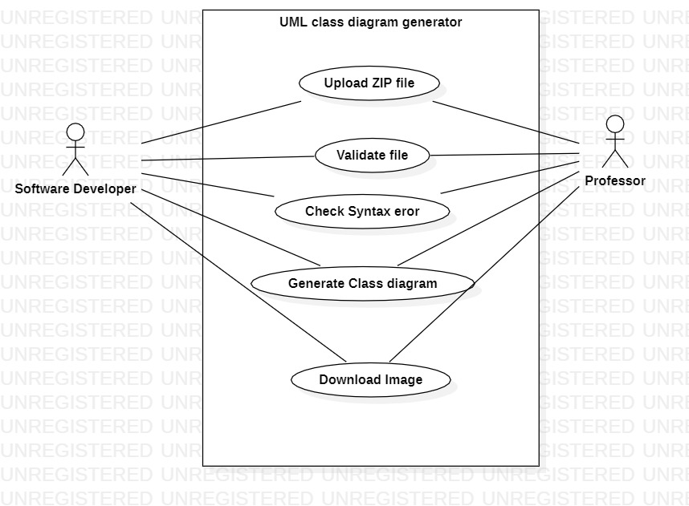
Use case diagram

Slide 9
Milestone1: user is able to upload zip file, zip file is validated and java files are validated milestone2: User is able to generate class diagram in cmd milestone3: User is able to view class diagram in website deliverable1: user is able to upload zip file, generate class diagram and download class diagram image
Milestones and deliverables

Slide 10
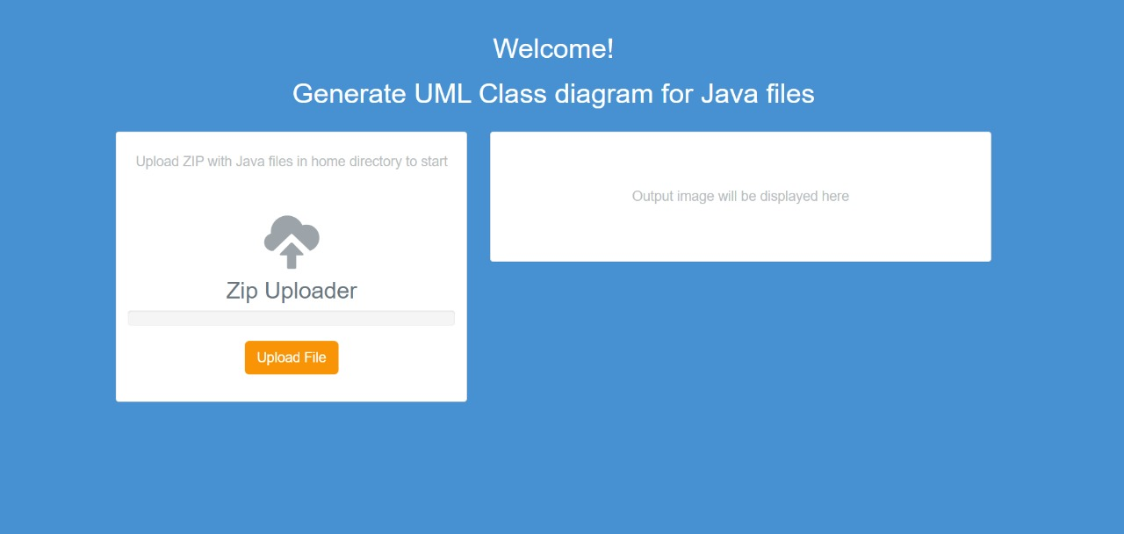
GUI DESIGN

Slide 11
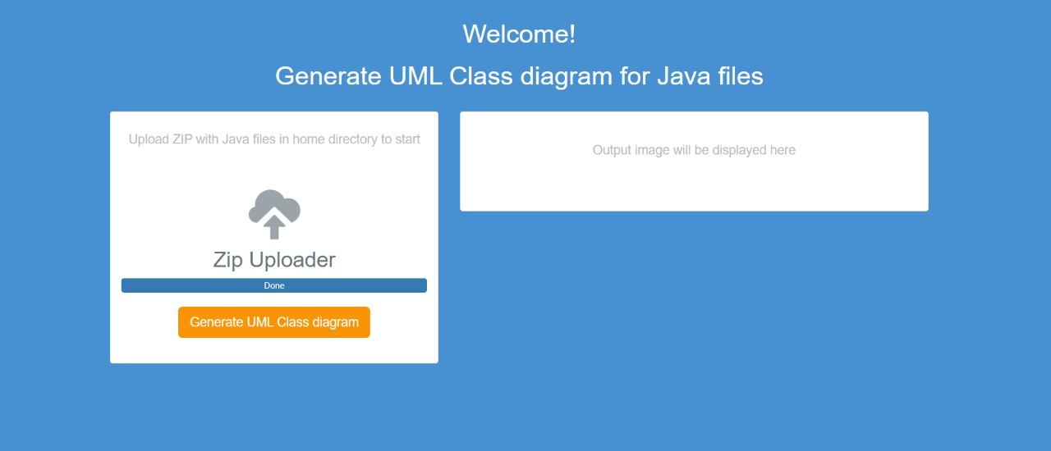
GUI DESIGN

Slide 12
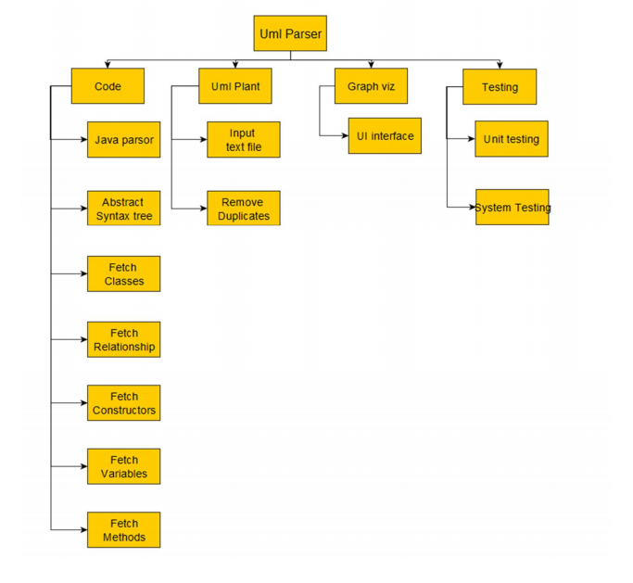
Work breakdown structure

Slide 13
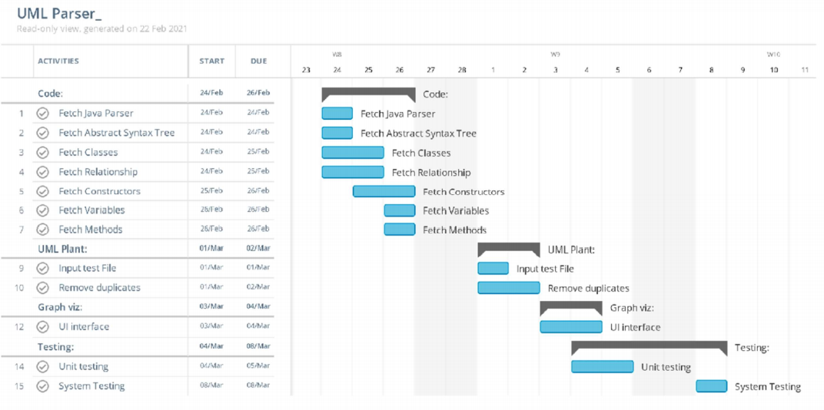
Gantt chart

Slide 14
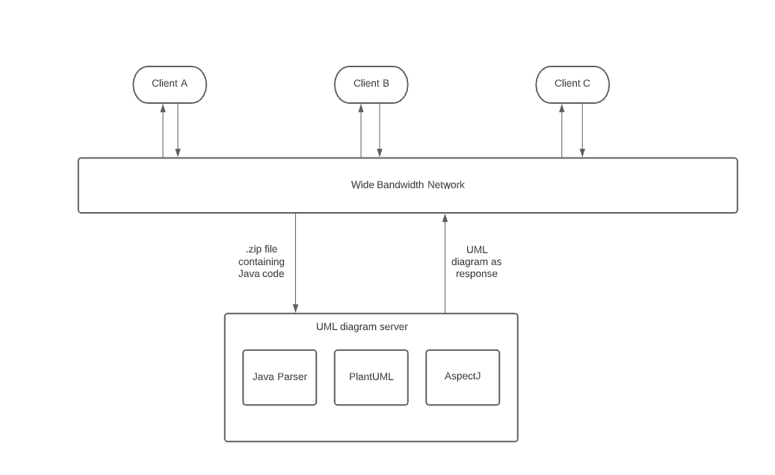
Architecture design

Slide 15
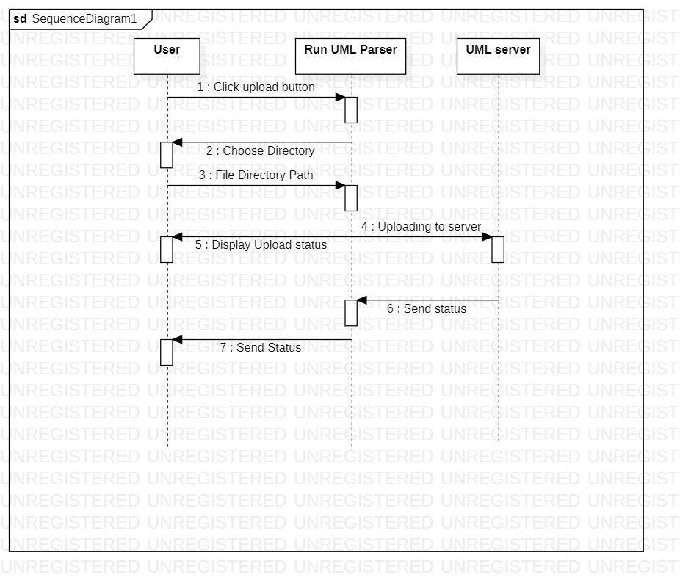
Sequence diagram

Slide 16
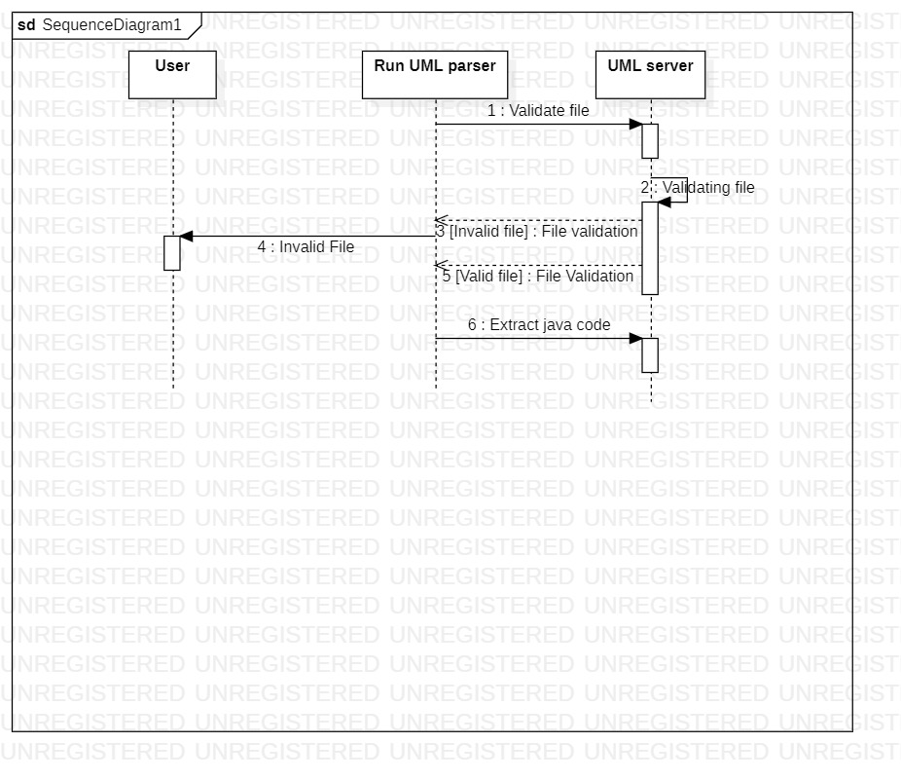
Sequence diagram

Slide 17
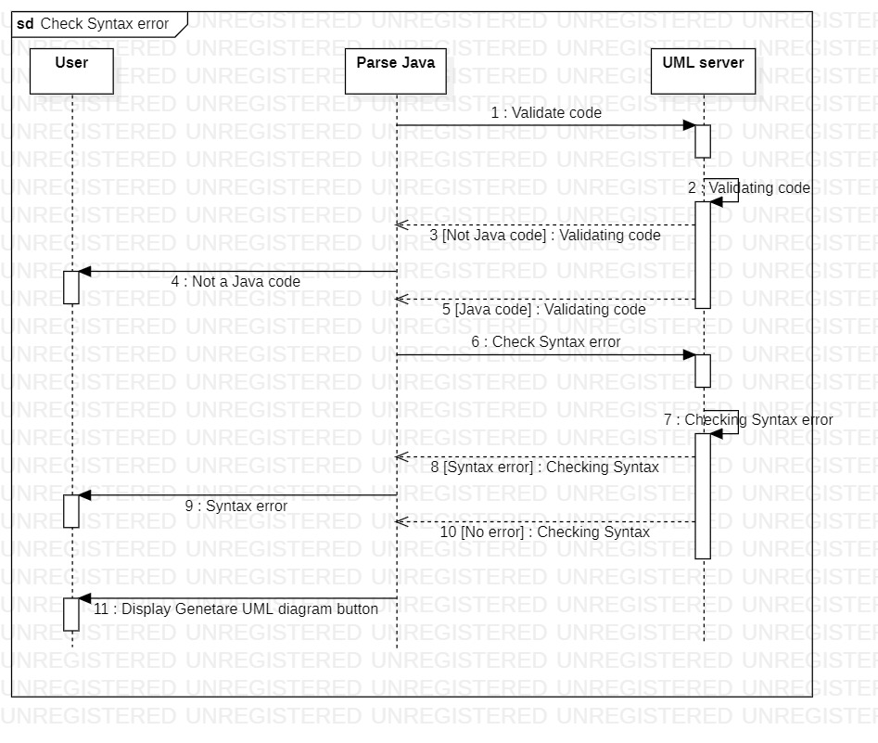
Sequence diagram

Slide 18
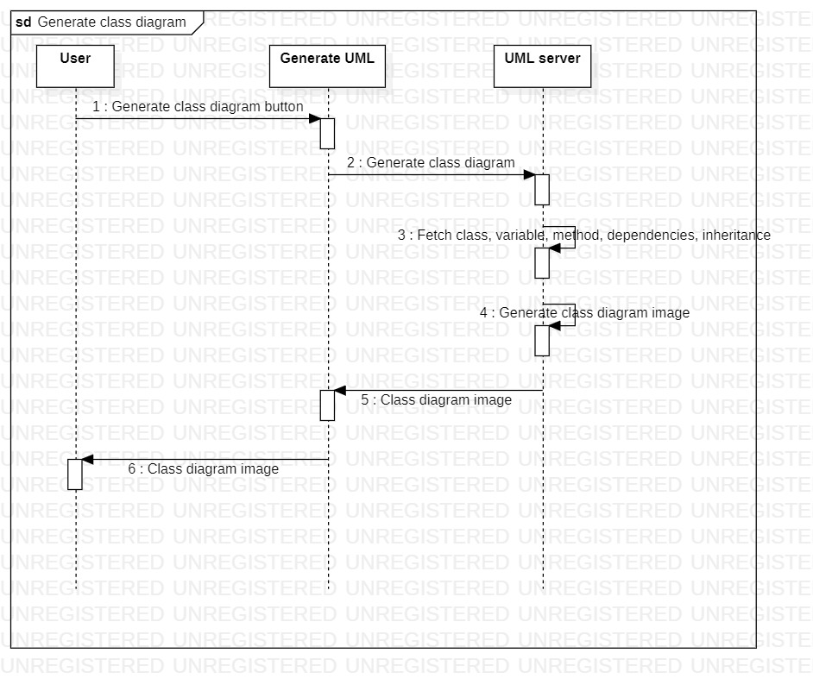
Sequence diagram

Slide 19
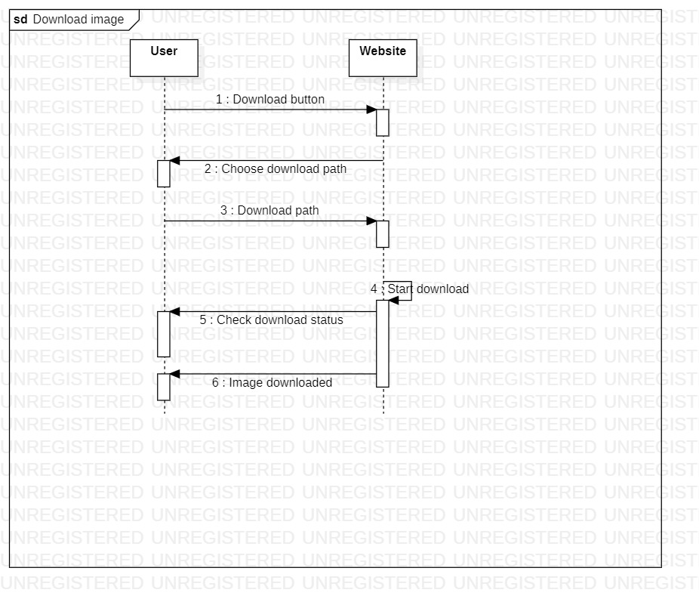
Sequence diagram

Slide 20
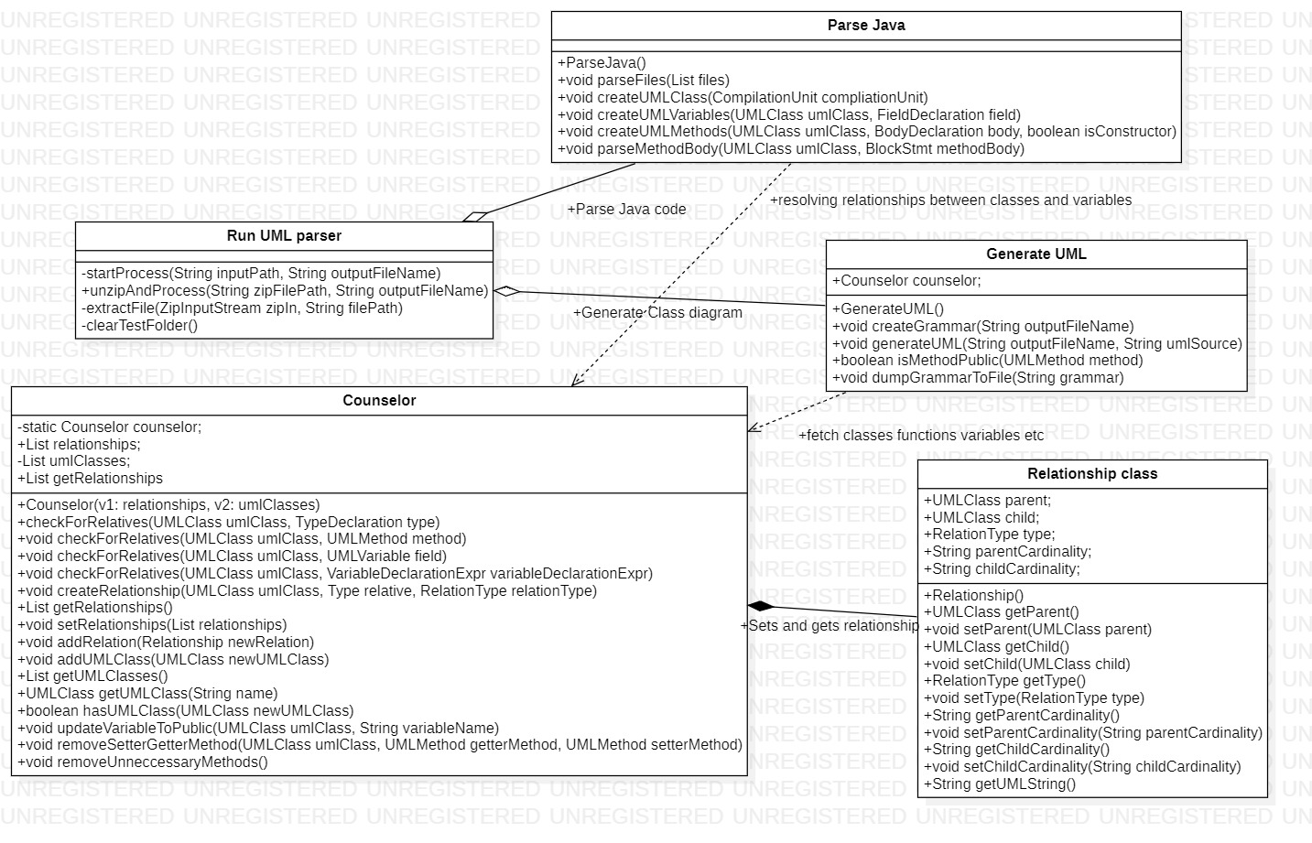
Class diagram

Slide 21
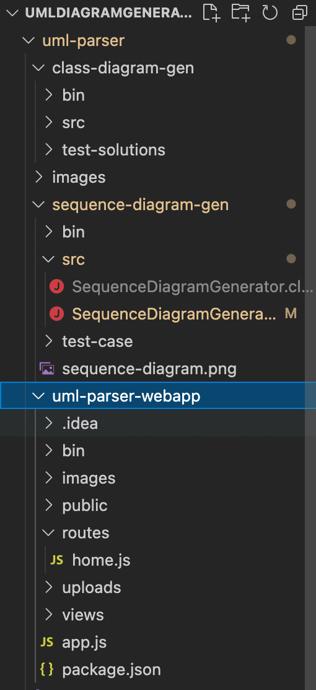
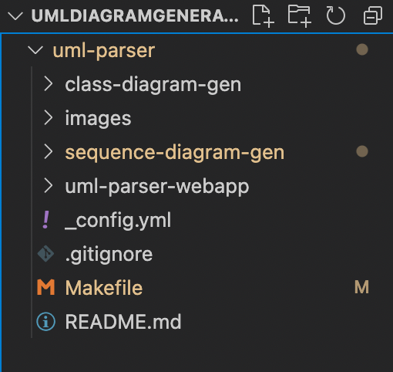
File structure
Code standards used

Slide 22
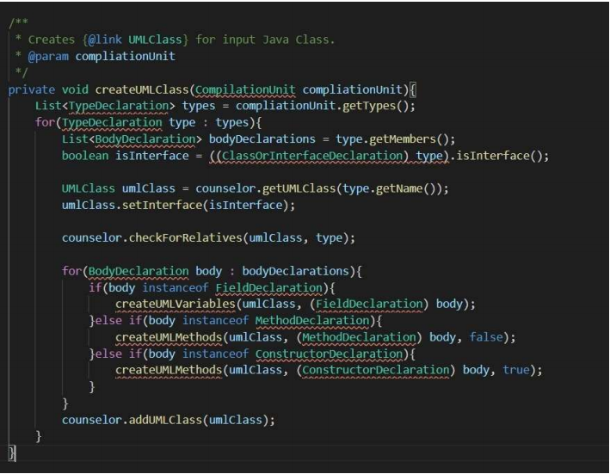
Naming convention for good readability
Code standards used

Slide 23
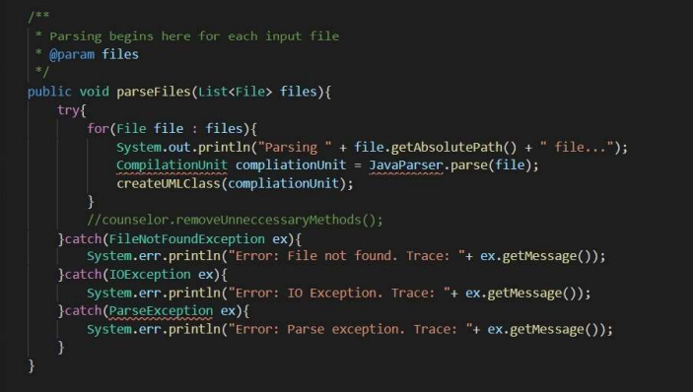
Handling errors and exceptions
Code standards used

Slide 24
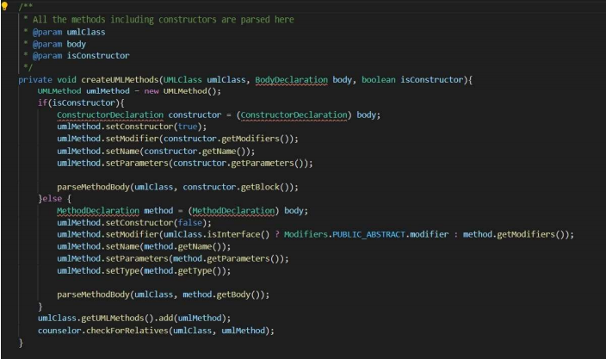
Providing comments
Code standards used

Slide 25
Constraints
The uploaded files SHALL only be processed if:
1. File size less than 15 MB
2. The file must be a .zip file
3. The zip file should contains Java code
4. The java code should be compiled
Alternatives
We could have used react instead of using HTML, CSS and JavaScript.
For backend we could have used python and can use it in Django/ Flask frameworks.
Constraints and alternatives

Slide 26
Key Features
1. The project is implemented using open source tools like plant UML, GraphViz and language used is java. So we can ensure that the project will be maintained forever.
2. The design is simple and easy to understand. User will have no difficulty in using the website.
3. User only sees a single functionality i.e. generation of UML class diagram but there are many functionalities that are abstract from the user.
4. The diagram obtained is error free as all the conditions are checked before generating diagram.
Result and discussion

Slide 27
Does the project satisfy the major requirement?
The major requirement is to generate an error free UML class diagram. It is generated by checking various conditions like syntax error, is the file compiled etc. So the project satisfies the major requirements.
What is the future version of the project?
The future version of the project will allow the user to create an account and save his UML diagrams in the website. It will also allow the user to share and download the UML diagram.
Can it be improved?
The project performs one major functionality i.e. generating UML class diagram which does not require any improvement. The class diagram standards will never change. The improvement can be done in design part.
Result and discussion

